Slide 1
Journey Presentation
Name: Manav Ananthakumar
Batch-4 IDA

Slide 2
Day 1 - Azure Storage Types
Azure Storage Services Overview
Azure Storage offers a range of services including Blob Storage, Data Lake Gen2, File Shares, Queues, and Tables.
Each service is tailored to specific data storage and processing needs, providing scalability and security.
Data Lake Gen2 vs. Blob Storage
Data Lake Storage Gen2 is optimized for big data analytics, supporting hierarchical file systems and analytics workloads.
Azure Blob Storage is a versatile object storage service suitable for unstructured data like images and documents.
The choice depends on your data and analytics requirements.
Managing Data Lake Gen2
Create and manage Data Lake Storage Gen2 using Azure Portal, CLI, PowerShell, or SDKs.
Key tasks include access control configuration, storage tier optimization, and organization using containers and folders.
Monitoring and auditing tools ensure security and performance.

Slide 3
Day 2 – Azure Storage Types and Introduction to Azure Data Factory
Access and Authentication
Azure Storage provides various authentication methods, including Shared Key, Shared Access Signature (SAS), and Azure AD-based authentication.
Secure access controls, such as RBAC and ACLs, help manage permissions for storage resources.
Ensuring proper authentication and authorization is crucial for data security in Azure Storage.
Secure Access to Azure Storage
Secure Azure Storage by limiting public access, utilizing private endpoints, and implementing virtual networks (VNETs) for enhanced security.
Azure Storage firewalls and virtual networks allow you to control inbound and outbound traffic effectively.
Secure configurations are vital to protect sensitive data stored in Azure Storage.
Introduction to Azure Data Factory (ADF)
Azure Data Factory is a cloud-based data integration service that enables ETL (Extract, Transform, Load) and ELT (Extract, Load, Transform) data workflows.
Key components of ADF include data sets for defining data sources, Integration Runtime for data movement, parameters for dynamic data processing, and system variables for controlling pipeline execution.
ADF facilitates the orchestration of data pipelines, enabling data transformation and integration at scale.

Slide 4
Day 3 – Azure Data Factory
ADF Components Overview
Azure Data Factory comprises several key components, including Data Sets, Linked Services, Pipelines, and Activities.
Data Sets define the data structures for source and destination data, while Linked Services establish connections to data stores.
Pipelines orchestrate data workflows, and Activities represent individual processing steps within those pipelines.
Copy Data Flow Activity
The Copy Data Flow Activity in ADF simplifies data movement and transformation tasks.
It supports copying data between various sources and sinks, including on-premises and cloud-based data stores.
You can apply data transformations, mapping, and data type conversions within this activity to ensure data consistency.
Control Flow and Other Activities
ADF provides a variety of control flow activities, including Get Metadata, Filter, If, Append, Wait, and ForEach Loop.
The Get Metadata Activity retrieves metadata about datasets, which can be useful for dynamic processing.
Filter, If, and Append activities allow conditional data processing and data merging.
Wait Activity enables time-based scheduling, while ForEach Loop simplifies iteration over datasets.
Lookup Activity is used to retrieve a single row from a dataset, often used for parameterization.

Slide 5
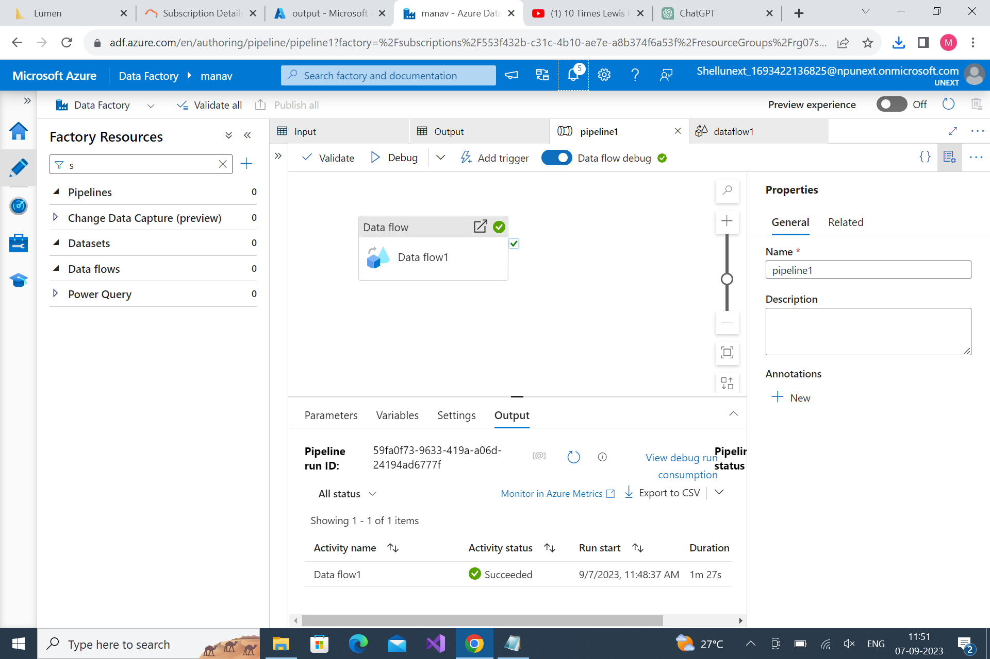

Slide 6
Day 4 – Azure Data Factory
Data Transformation with Mapping Dataflow
Mapping Dataflow Transformation in Azure Data Factory empowers users to perform complex data transformations with a visual interface.
Source Transformation allows data extraction and initial transformation from various sources.
Sink Transformation handles data loading into target destinations, ensuring efficient data movement.
API-Based Integration
APIs play a pivotal role in modern software development, facilitating data exchange and functionality access between applications.
Understanding API-based integration patterns and architectures is crucial for building scalable and interoperable systems.
Best practices guide the design and development of APIs, ensuring reliability, security, and ease of use.
API Consumption and Change Data Capture (CDC)
Exploring API consumption techniques and integration methods is essential for connecting with external services and leveraging their capabilities.
API authentication and authorization mechanisms are fundamental for secure API access.
Change Data Capture (CDC) is a key concept for real-time data synchronization, providing valuable insights into data changes across databases and systems.

Slide 7
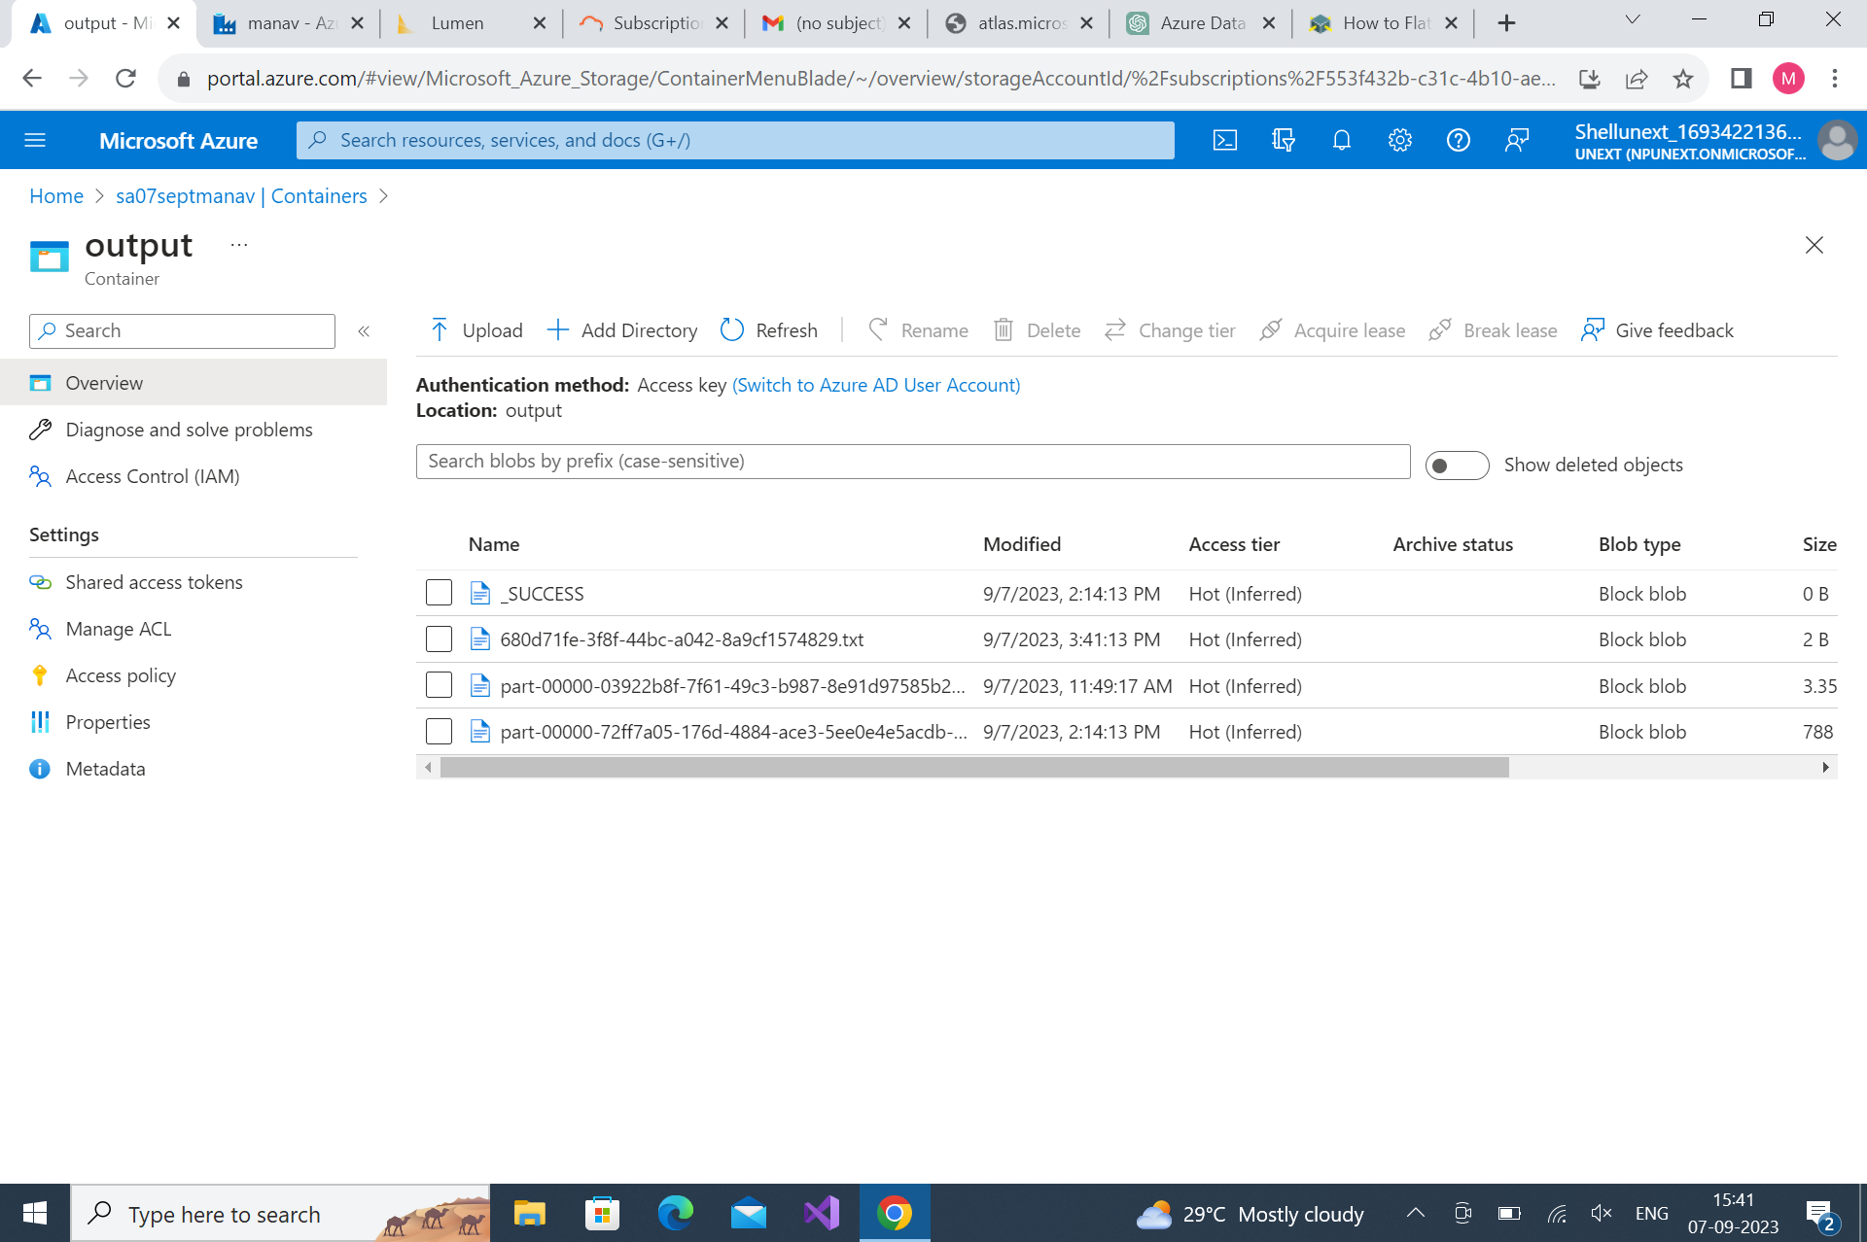

Slide 8
Day 5 – Azure Data Factory
CDC Implementation and Architecture
Explore various CDC implementation approaches, considering architectural aspects for different scenarios.
Implement CDC using both database-level and log-based techniques to capture and propagate data changes.
Real-time data synchronization with CDC is vital for keeping data consistent across systems, including handling conflicts and resolution strategies.
Azure Error Handling and Debugging
Error handling and debugging are crucial in Azure to ensure the reliability and performance of applications and services.
Understand common error types and scenarios in Azure applications and services.
Utilize Azure services and tools, such as Azure Application Insights and Azure Log Analytics, for effective error handling and debugging.
Azure Monitoring, Alerting, and Automation
Azure Monitor provides a comprehensive overview of your Azure resources and their performance.
Learn how to configure and manage alerts in Azure Monitor to proactively detect and respond to issues.
Azure Automation simplifies task scheduling and automation, allowing you to create and manage runbooks for automated tasks.

